Slide 1



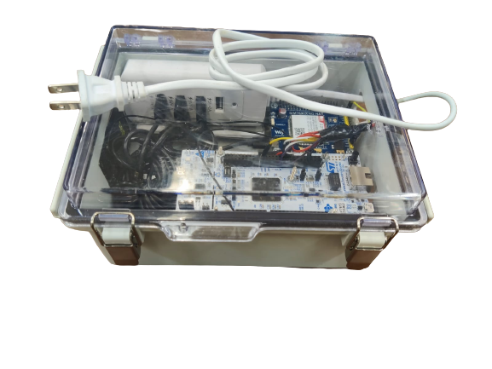
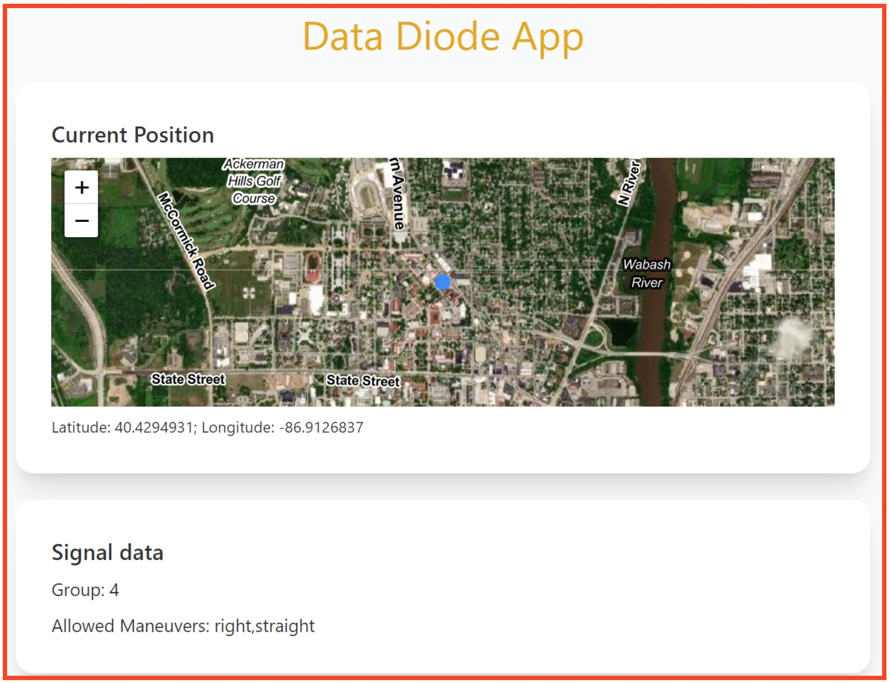
Secured Acquisition of Intersection Data for Connected Vehicles Operations Walton Fehr Mark Goodfriend Samuel Labi James V. Krogmeier Montasir Abbas Andrew Balmos Manish Kumar Richard Ajagu David Hong

Slide 2
Secured Acquisition of Intersection Data for Connected Vehicles Operations
Objective is to extract Signal Phase and Timing (SPaT) data from a Traffic Signal Controller (TSC) cabinet
Solution uses an economical Data-Diode housing two microcontrollers linked via simplex connection
Diode data is routed to different channels through NATS and stored in Postgres database
Utilize SPaT data to provide precise timing on driver’s phone
Backend script detects user location and finds nearest intersection
User's phone shows TSC lane's light status

Slide 3
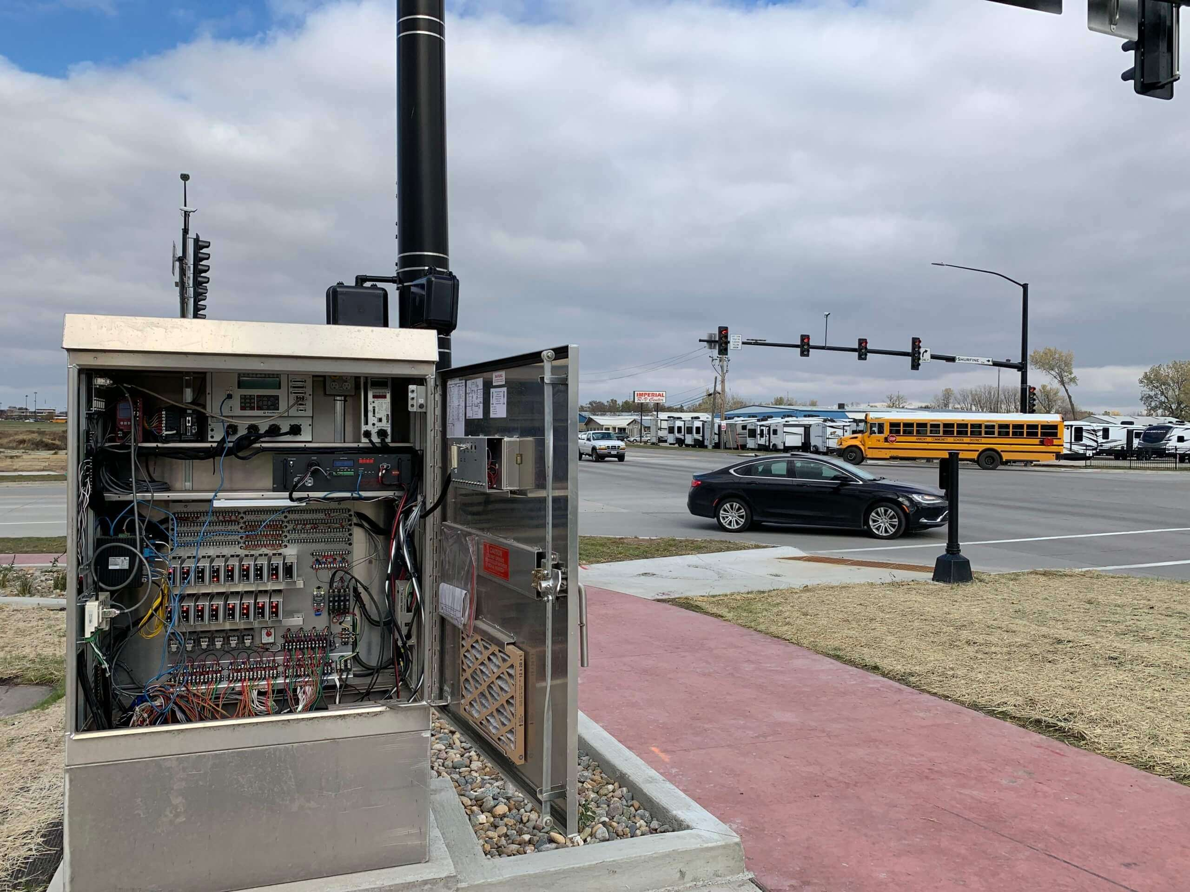
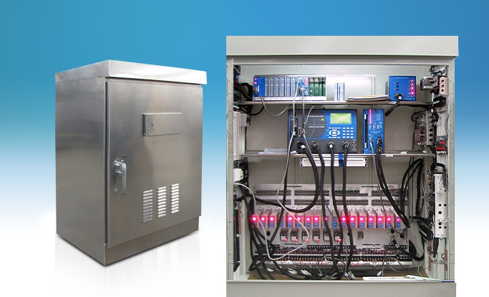
TSC Cabinet

Slide 4
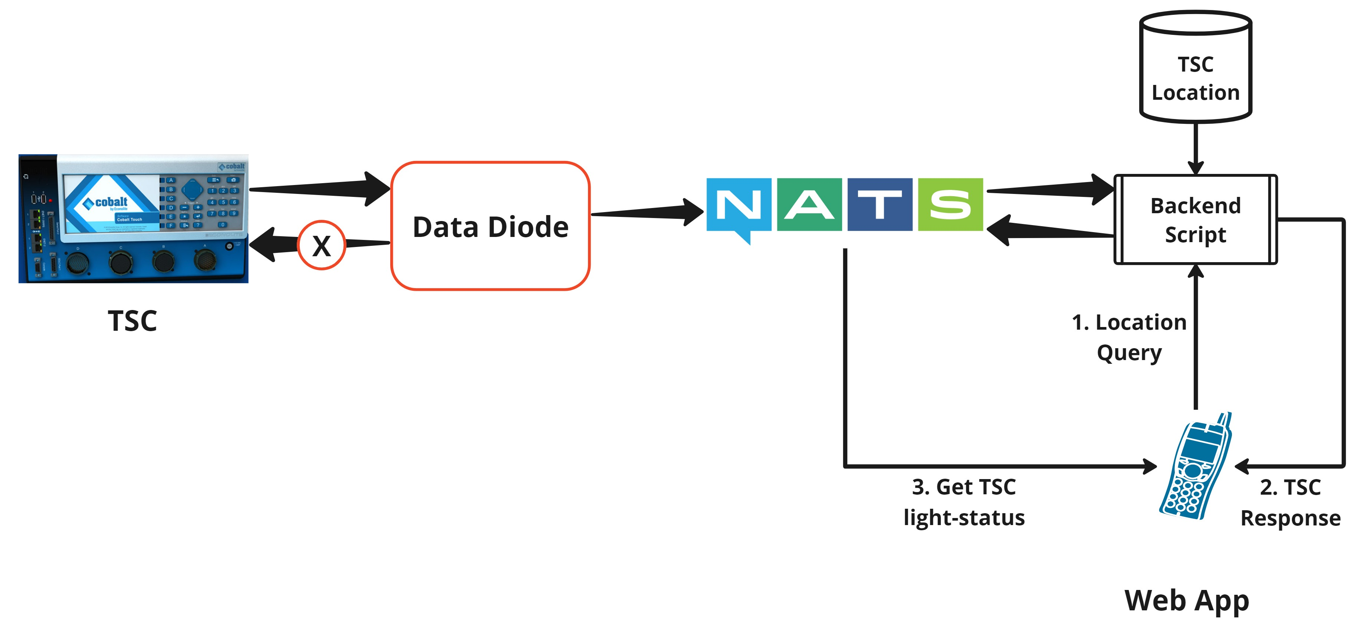
System Workflow

Slide 5
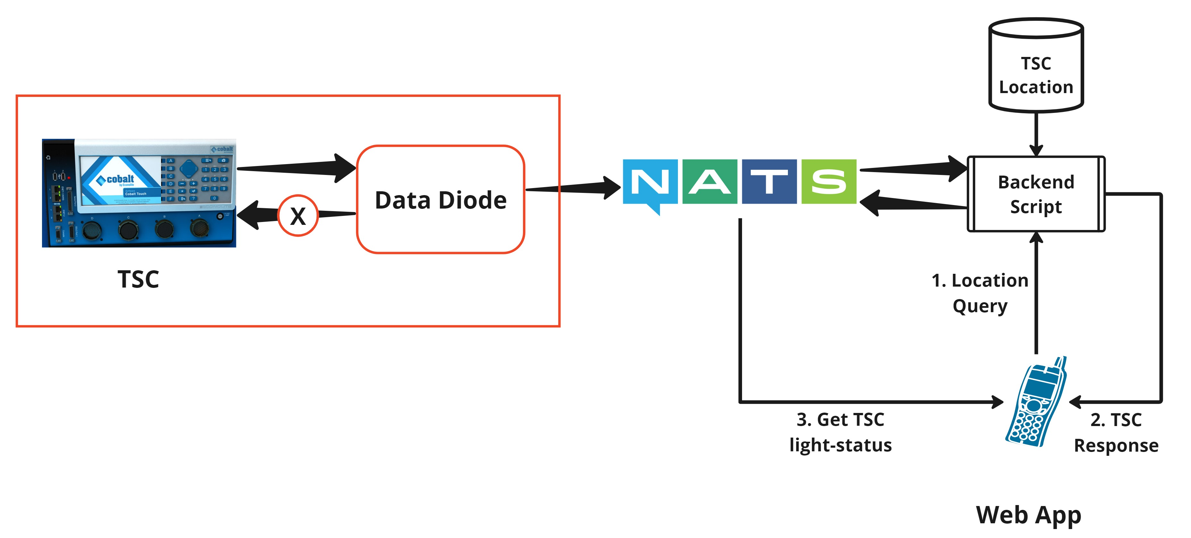
Data-Diode

Slide 6
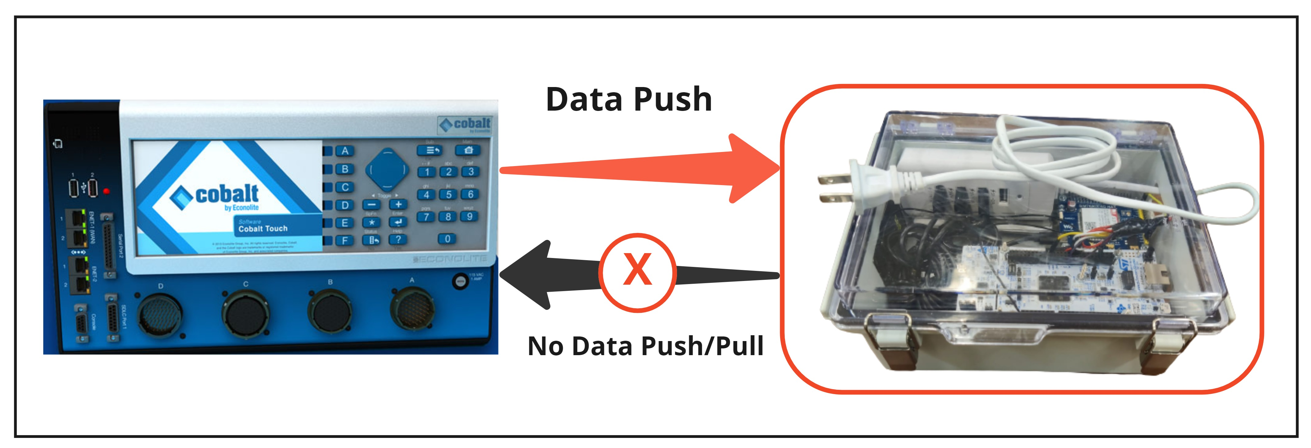
Data-Diode

Slide 7
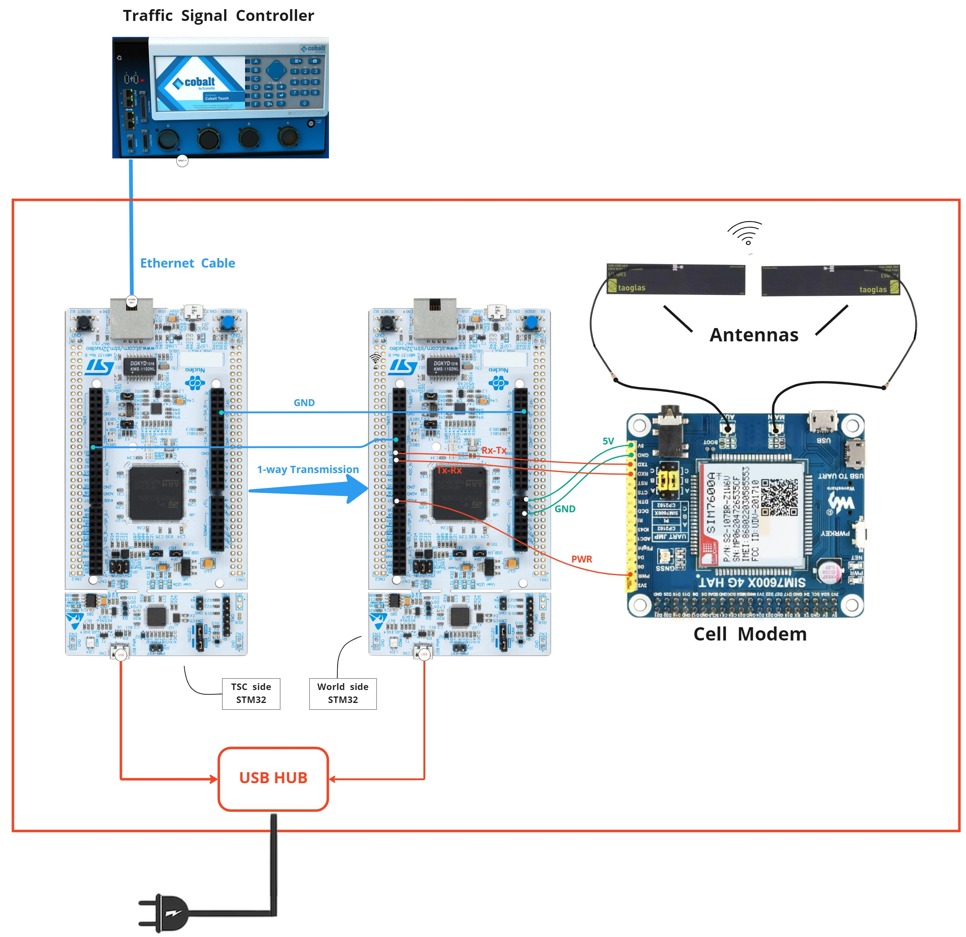
Components of Data Diode

Slide 8
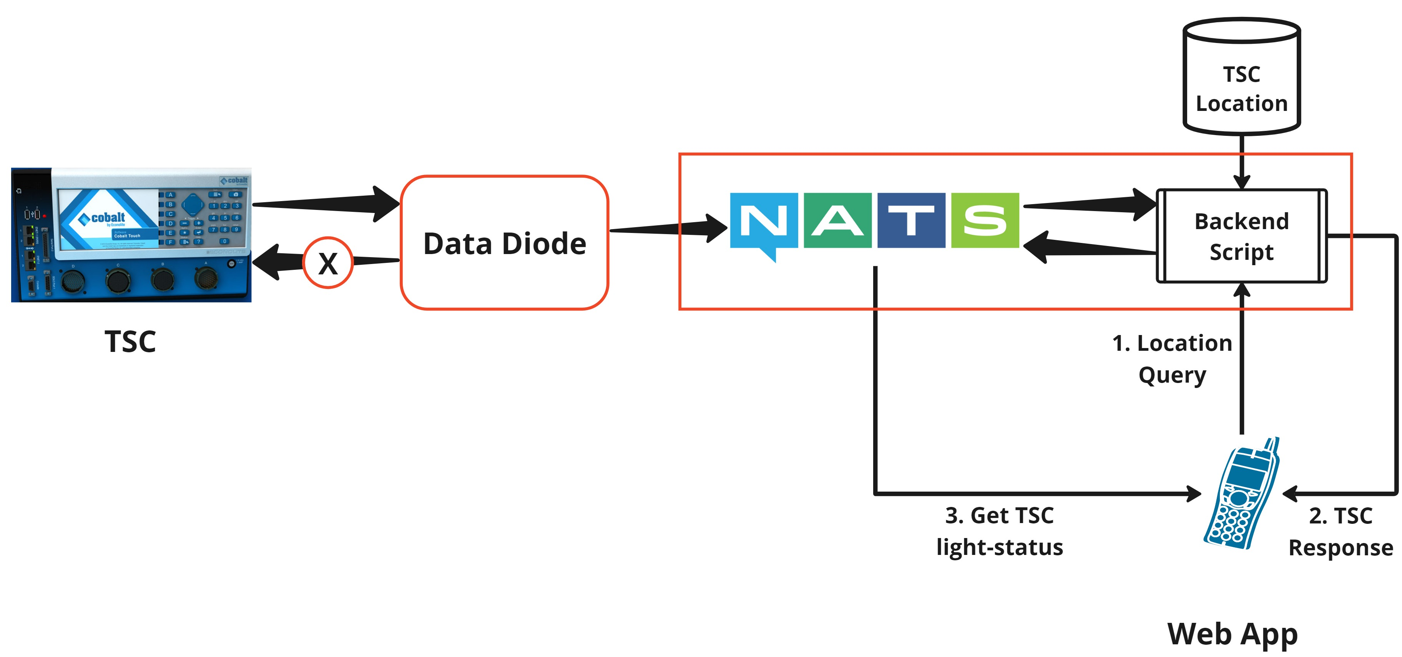
NATS Data Routing

Slide 9
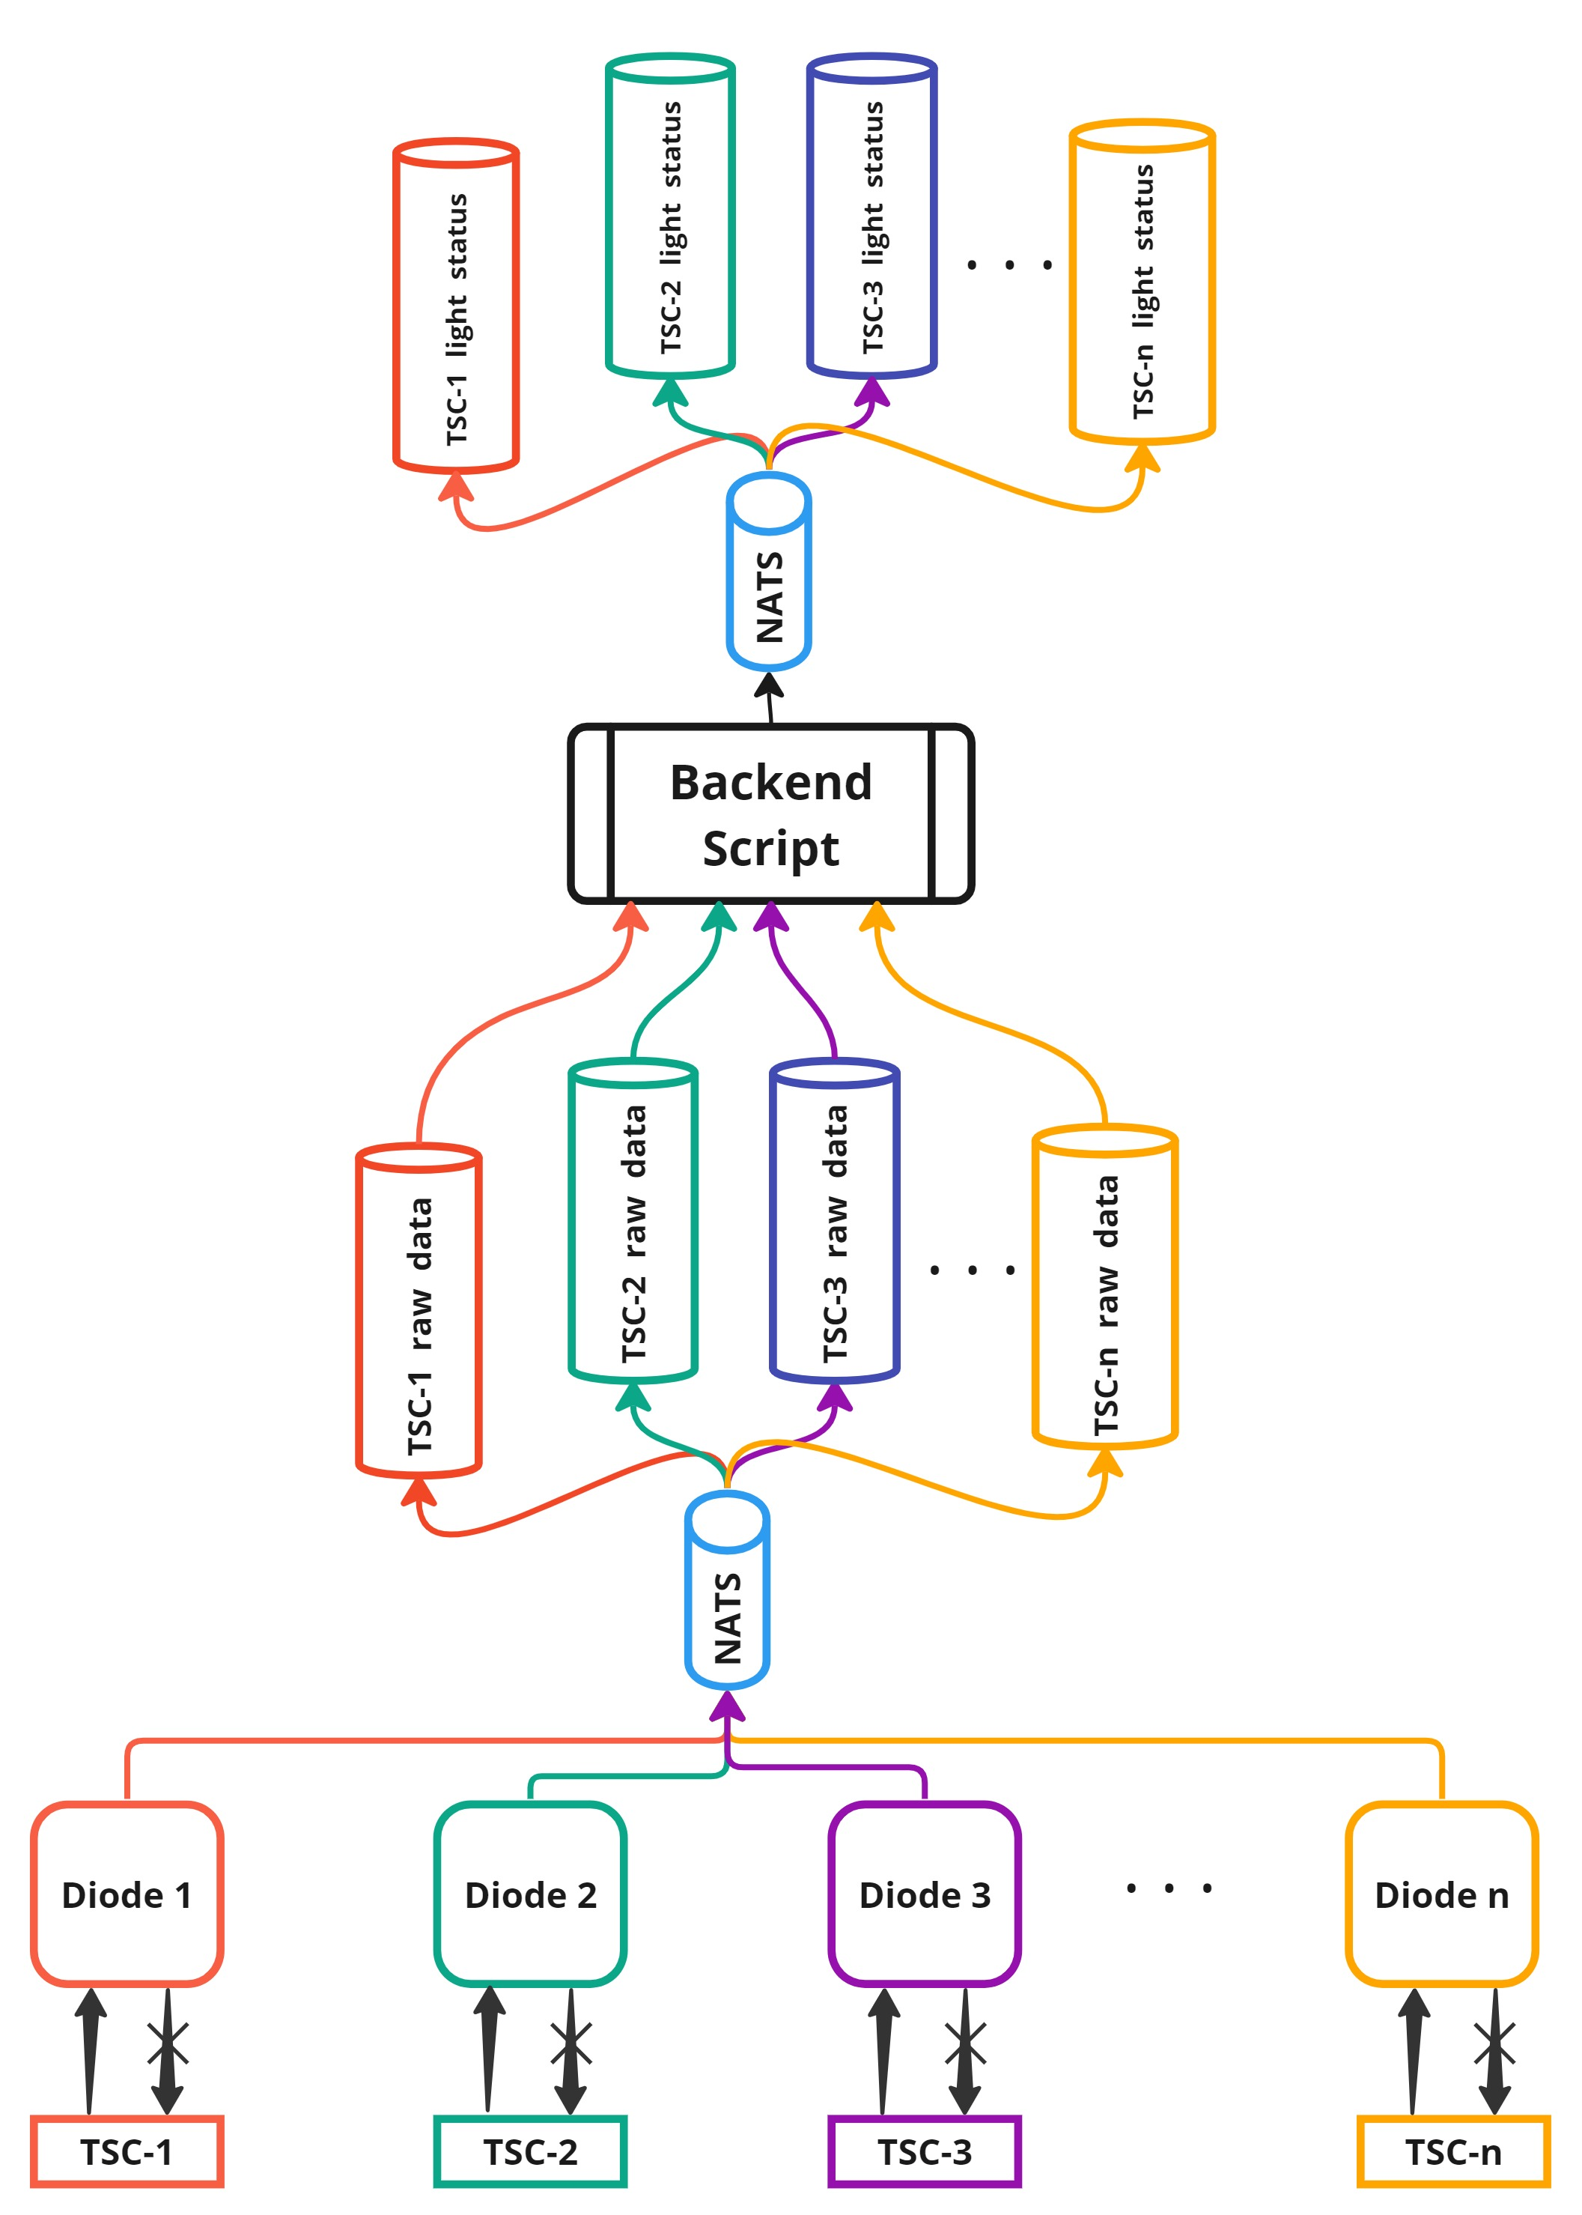

Slide 10
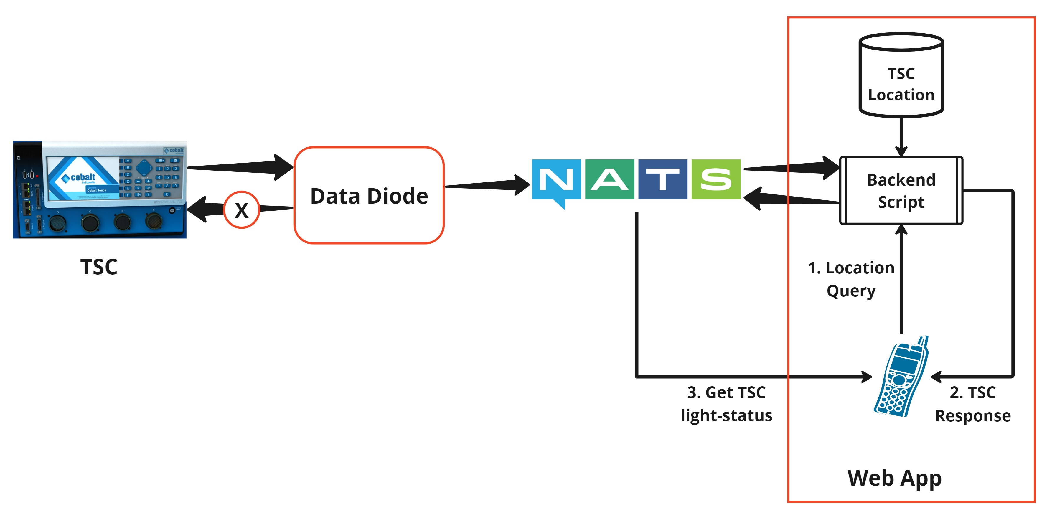
Web App

Slide 11
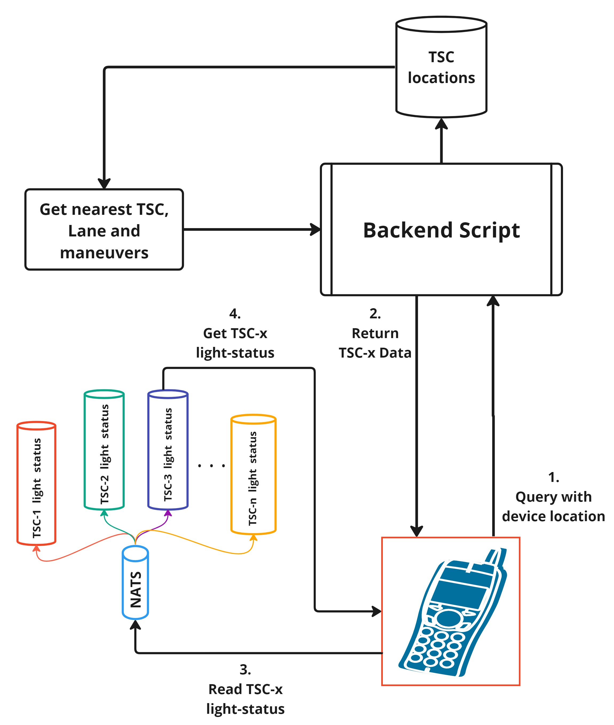
Web App - Backend

Slide 12
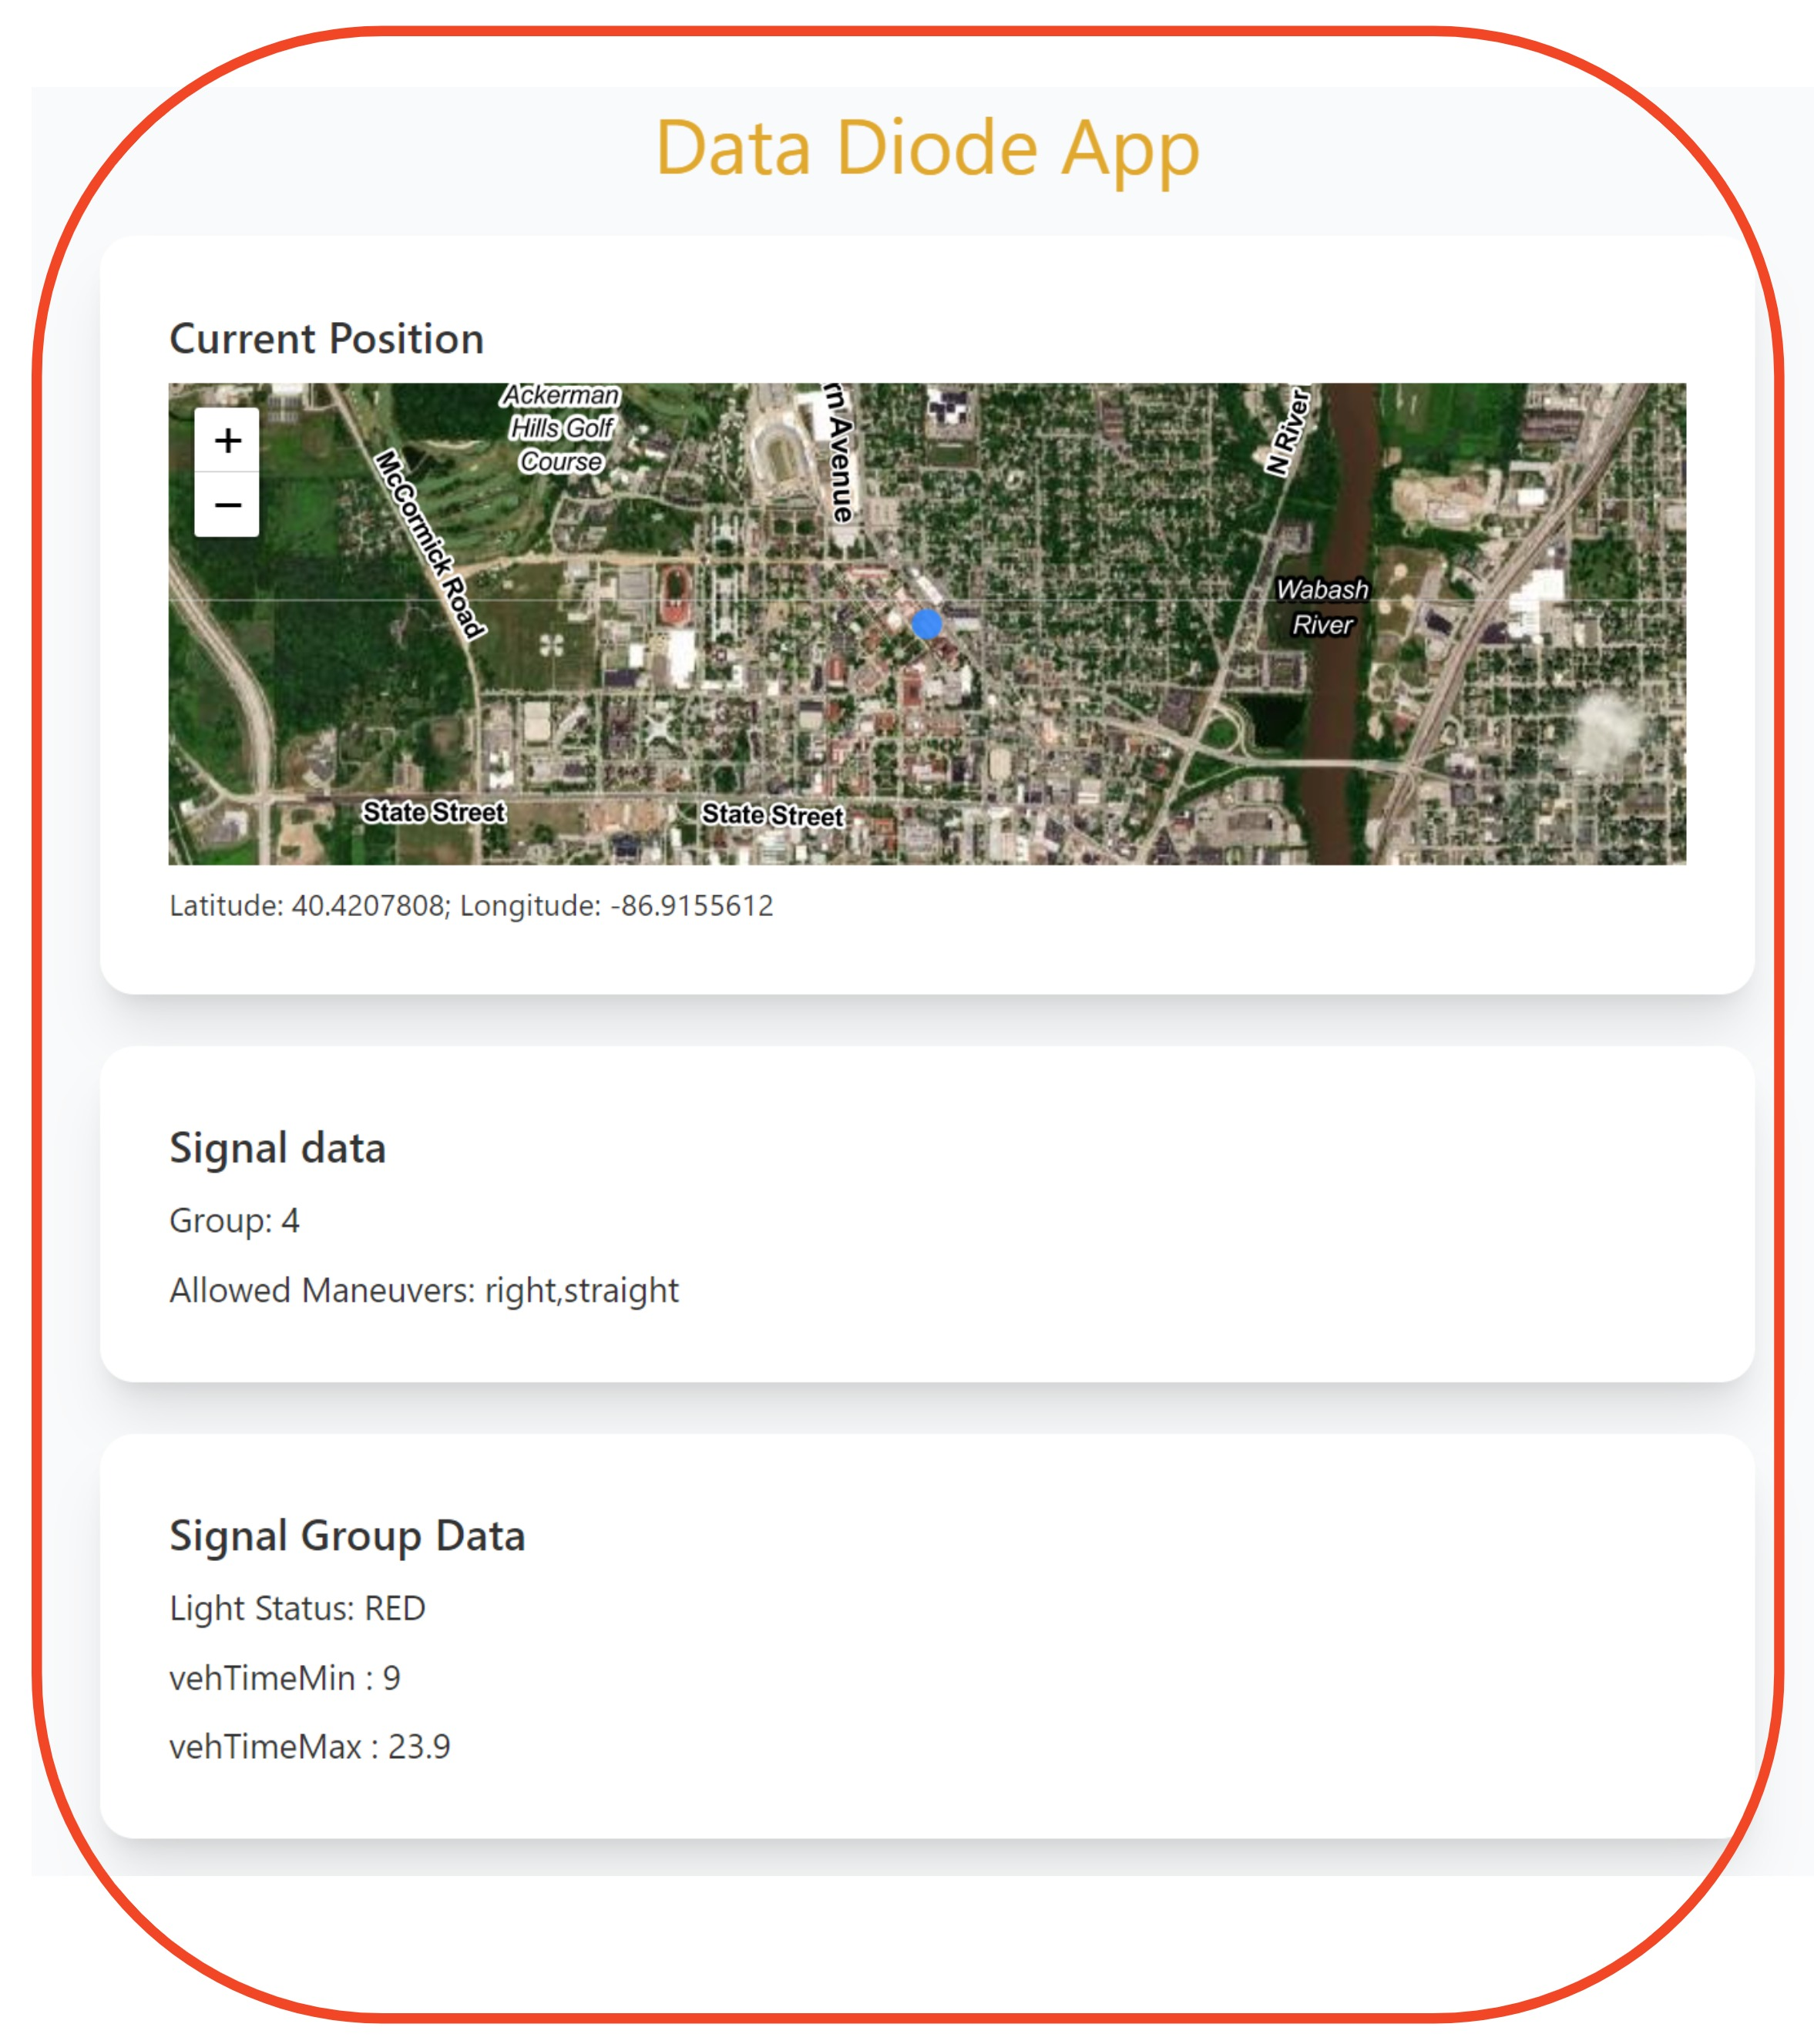
Web App - Frontend https://diode.oatscenter.org/
Query the server with coordinates
Obtain the Traffic Light status in its lane
Display the Light status

Slide 13
Installation – Plug n Play!
Connect Ethernet cable from TSC to Data Diode’s Ethernet port
1
Plug in the power cable and power the system
2
Broadcast TSCBM
3
Obtain TSC data using web app
4

Slide 14
Data Diode Goals
System Integrity
Economical Data Acquisition
Ease of Installation
Data Visualization
Real Time Response

Slide 15

Demo & Questions

